Slide 1
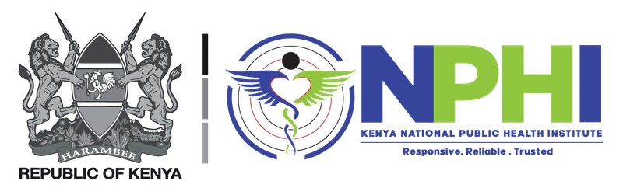


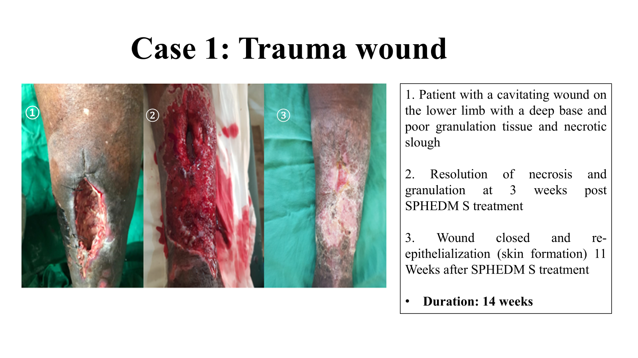
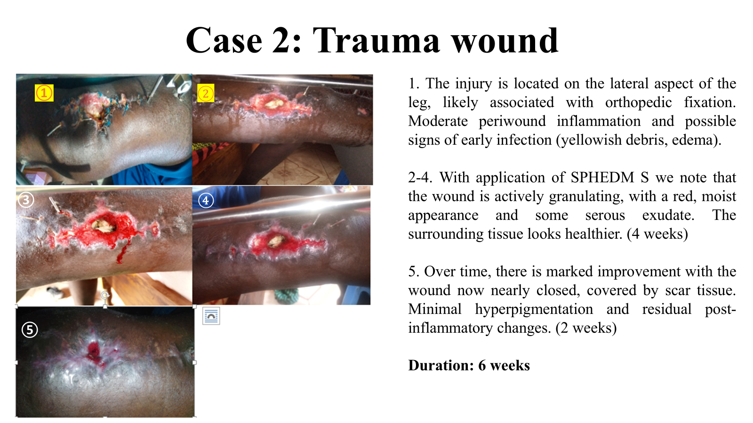
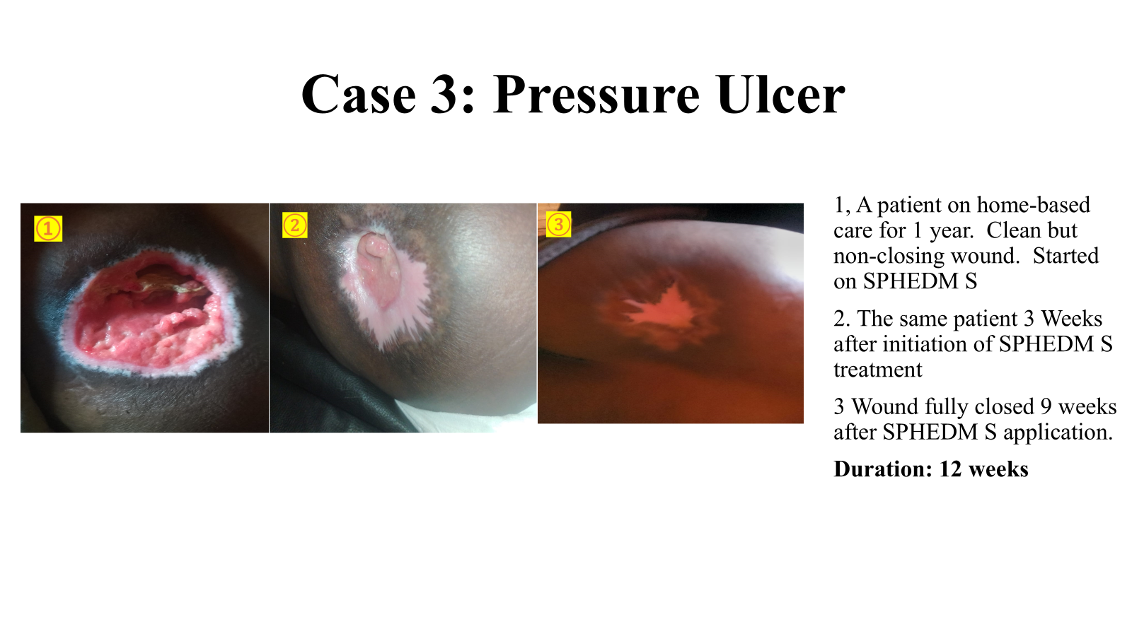
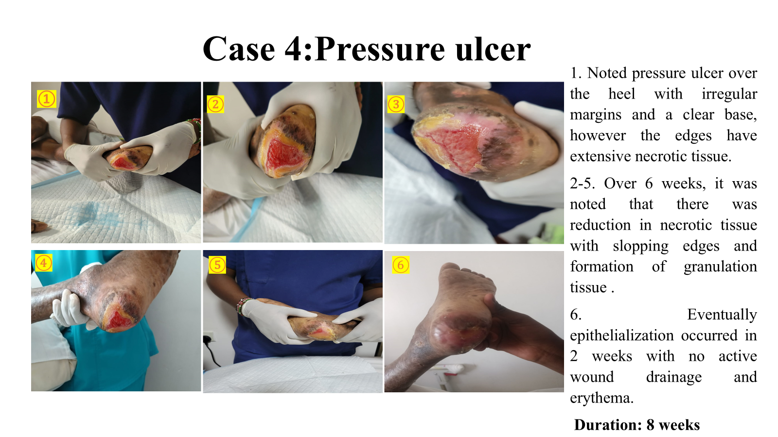
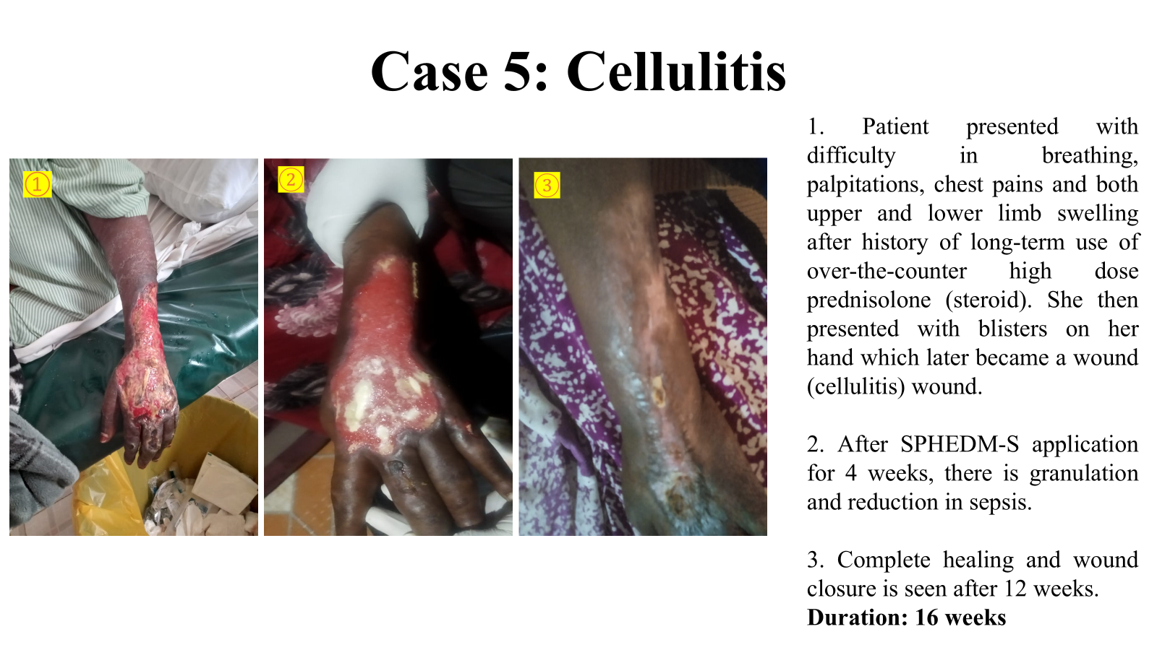
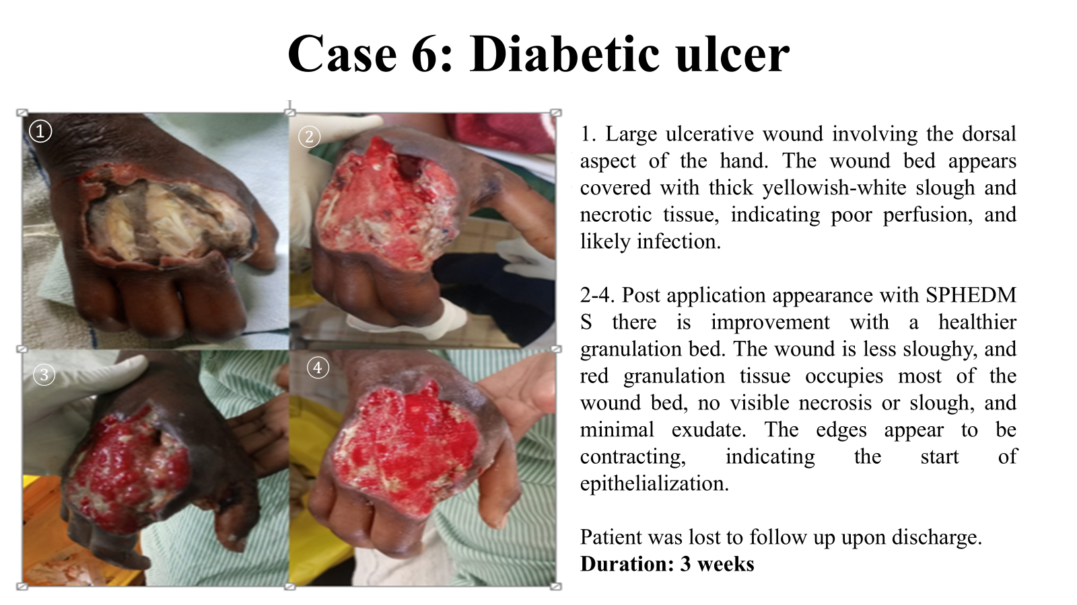
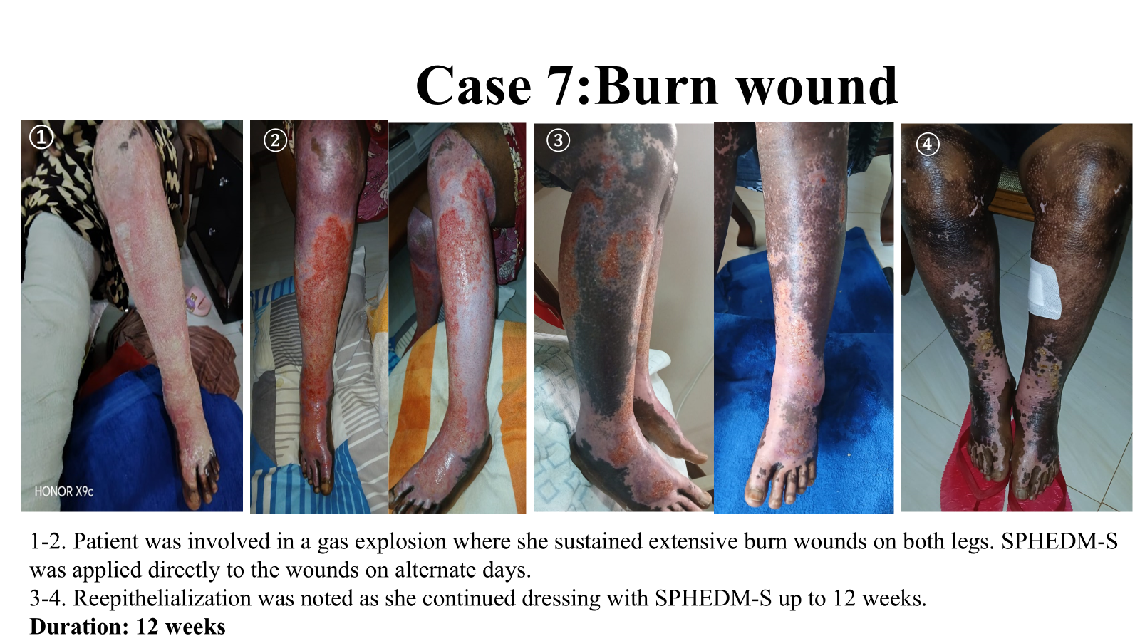
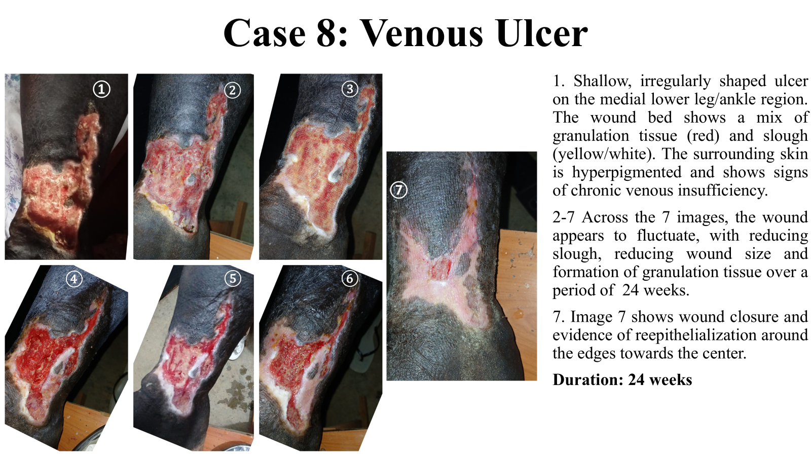
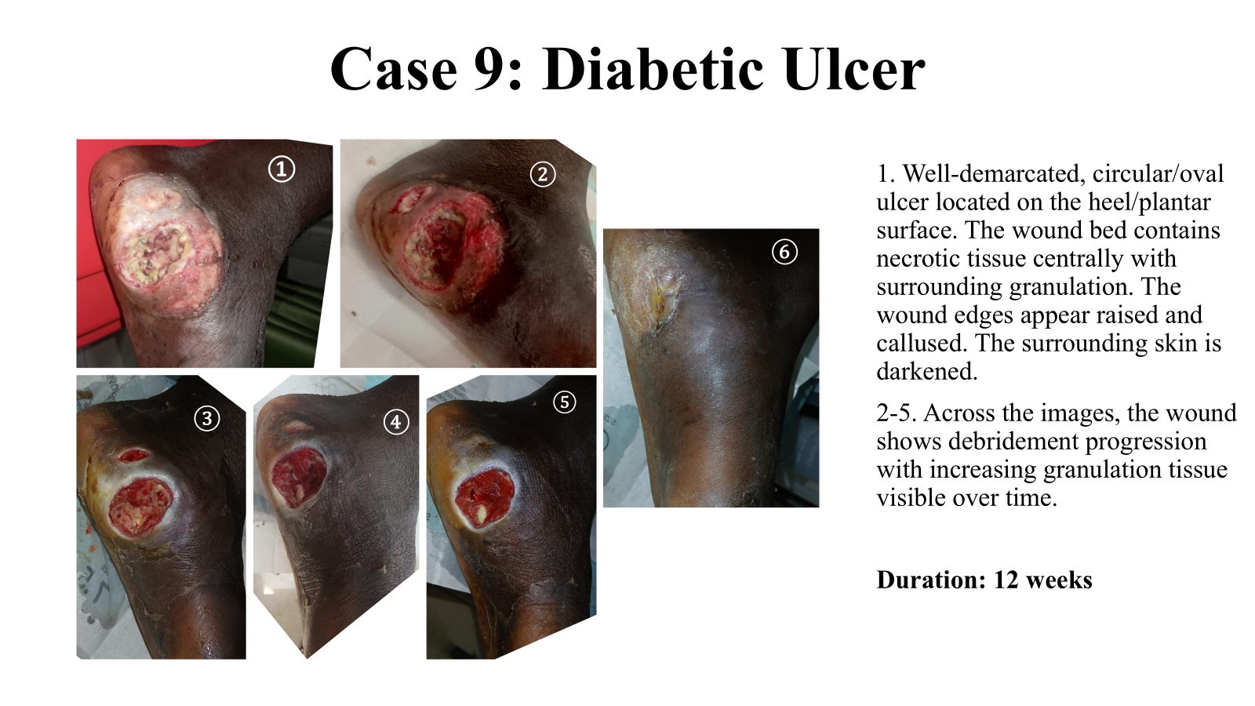



EXPLORING THE EFFECTIVENESS OF A PATENTED EXTEMPORANEOUS PREPARATION (SPHEDM-S) ON CHRONIC WOUND MANAGEMENT.
Dr. James Katoloki¹, Dr. Divinah Nyairabu¹, Dr. Joyster Mungania¹, Dr. Tejal Patel³, Prof. Charity Gichuki²
1: Pharmacy Department, Meru Teaching and Referral Hospital(MeTRH). 2:Meru University of Science and Technology(MUST) 3:University of Nairobi, School of medicine
BACKGROUND
Chronic wounds are a silent epidemic, and their management has an economic impact on the healthcare system due to their increasing prevalence, complications, and cost. The burden is high in low- and middle-income countries.
In United States, chronic non healing wounds impact about 8.2 million of their patients. Cost projections for all wounds ranged from 28.1 to 96.8 billion, including costs for infections management, among which surgical wounds and diabetic ulcers were the most expensive to treat. In Africa, a study showed injury as the leading cause of disability and death, over 5 million deaths per year.
SPHEDM-S is a patented topical extemporaneous preparation innovated by a group in Meru County. It contains FDA approved agents that encourage a suitable wound-healing environment using different mechanisms of action for better and faster healing. Clinical observations were carried out in Meru Teaching and Referral Hospital (MeTRH).
OBJECTIVE:
To evaluate the effectiveness of SPHEDM-S on chronic wounds in Meru Teaching and Referral Hospital
STUDY SITE
Meru Teaching and referral Hospital, Meru County
METHODOLOGY:
SPHEDM-S was applied on alternate days to chronic wounds that had not improved using standard of care. This was an “end-resort “-treatment of unhealing chronic wounds of various etiologies including diabetic ulcers, venous ulcers, cellulitis, pressure sores, gastroschisis, fournier’s gangrene and trauma wounds. Most of these wounds were painful, necrotic and fungating. Patients and care-givers gave verbal consent after full disclosure that this was an experimental preparation. Clinical observations were made and photos of the wounds were taken during the subsequent dressing period for documentation.
.
RESULTS
CONCLUSION
SPHEDM-S hastened the healing of chronic wounds, improved the patients’ quality of life, treatment outcomes and reduced treatment costs. There’s a need for more research on the SPHEDM-S scalability in improving wound care practices for quality wound management and optimization of patient outcomes. We are currently preparing to undertake phase II clinical trials.
Contact: jilmwisya@gmail.com

